Slide 1
Overview
Data Mining for Business Analytics in R
Shmueli, Bruce, Yahav, Patel & Lichtendahl

Slide 2
Core Ideas in Data Mining
Classification
Prediction
Association Rules & Recommenders
Data & Dimension Reduction
Data Exploration
Visualization

Slide 3
Paradigms for Data Mining (variations)
SEMMA (from SAS)
  Sample
  Explore
  Modify
  Model
  Assess
CRISP-DM (SPSS/IBM)
  Business Understanding
  Data Understanding
  Data Preparation
  Modeling
  Evaluation
  Deployment

Slide 4
Supervised Learning
Goal: Predict a single “target” or “outcome” variable
Training data, where target value is known
Score to data where value is not known
Methods: Classification and Prediction

Slide 5
Unsupervised Learning
Goal: Segment data into meaningful segments; detect patterns
There is no target (outcome) variable to predict or classify
Methods: Association rules, data reduction & exploration, visualization

Slide 6
Supervised: Classification
Goal: Predict categorical target (outcome) variable
Examples: Purchase/no purchase, fraud/no fraud, creditworthy/not creditworthy…
Each row is a case (customer, tax return, applicant)
Each column is a variable
Target variable is often binary (yes/no)

Slide 7
Supervised: Prediction
Goal: Predict numerical target (outcome) variable
Examples: sales, revenue, performance
As in classification:
Each row is a case (customer, tax return, applicant)
Each column is a variable
Taken together, classification and prediction constitute “predictive analytics”

Slide 8
Unsupervised: Association Rules
Goal: Produce rules that define “what goes with what”
Example: “If X was purchased, Y was also purchased”
Rows are transactions
Used in recommender systems – “Our records show you bought X, you may also like Y”
Also called “affinity analysis”

Slide 9
Unsupervised: Data Reduction
Distillation of complex/large data into simpler/smaller data
Reducing the number of variables/columns (e.g., principal components)
Reducing the number of records/rows (e.g., clustering)

Slide 10
Unsupervised: Data Visualization
Graphs and plots of data
Histograms, boxplots, bar charts, scatterplots
Especially useful to examine relationships between pairs of variables

Slide 11
Data Exploration
Data sets are typically large, complex & messy
Need to review the data to help refine the task
Use techniques of Reduction and Visualization

Slide 12
The Process of Data Mining

Slide 13
Steps in Data Mining
Define/understand purpose
Obtain data (may involve random sampling)
Explore, clean, pre-process data
Reduce the data; if supervised DM, partition it
Specify task (classification, clustering, etc.)
Choose the techniques (regression, CART, neural networks, etc.)
Iterative implementation and “tuning”
Assess results – compare models
Deploy best model

Slide 14
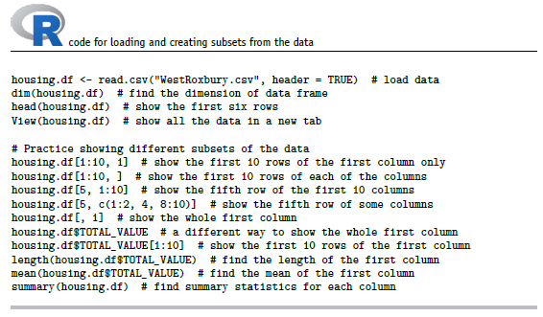
Preliminary Exploration in R loading data, viewing it, summary statistics

Slide 15
Obtaining Data: Sampling
Data mining typically deals with huge databases
For piloting/prototyping, algorithms and models are typically applied to a sample from a database, to produce statistically-valid results
Once you develop and select a final model, you use it to “score” (predict values or classes for) the observations in the larger database

Slide 16
Rare Event Oversampling
Often the event of interest is rare
Examples: response to mailing, fraud in taxes, …
Sampling may yield too few “interesting” cases to effectively train a model
A popular solution: oversample the rare cases to obtain a more balanced training set
Later, need to adjust results for the oversampling

Slide 17
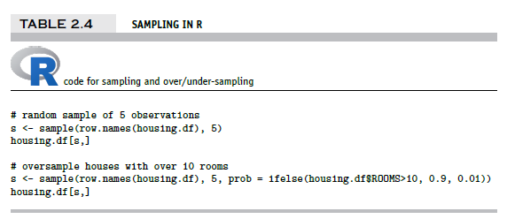
Sampling & Oversampling

Slide 18
Types of Variables
Determine the types of pre-processing needed, and algorithms used
Main distinction: Categorical vs. numeric
Numeric
  Continuous
  Integer
Categorical
  Ordered (low, medium, high)
  Unordered (male, female)

Slide 19
Variable handling
Numeric
  Most algorithms can handle numeric data
  May occasionally need to “bin” into categories
Categorical
  Naïve Bayes can use as-is
  In most other algorithms, must create binary dummies (number of dummies = number of categories – 1) [see Table 2.6 for R code]

Slide 20
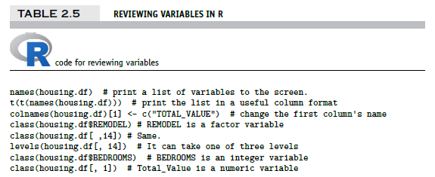
Reviewing Variables in R
a double matrix transpose using t (transpose) function
output on next slide…

Slide 21
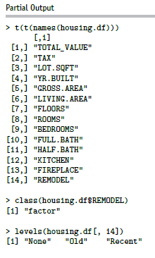
Output of code on previous slide

Slide 22
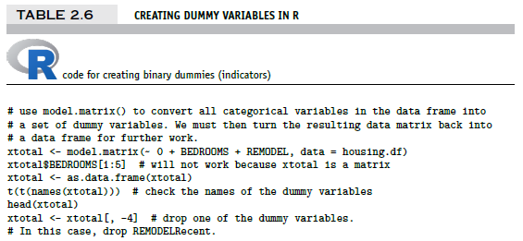
Creating binary dummies
#now, put it all together again, drop original REMODEL from the data
housing.df <- cbind(housing.df[, -c(9, 14)], xtotal)
t(t(names(housing.df)))
output on next slide…

Slide 23
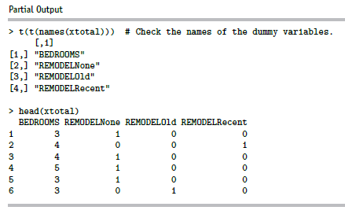
Creating Binary Dummies – Output
Note: R’s lm function automatically creates dummies, so you can skip dummy creation when using lm

Slide 24
Detecting Outliers
An outlier is an observation that is “extreme”, being distant from the rest of the data (definition of “distant” is deliberately vague)
Outliers can have disproportionate influence on models (a problem if it is spurious)
An important step in data pre-processing is detecting outliers
Once detected, domain knowledge is required to determine if it is an error, or truly extreme.

Slide 25
Detecting Outliers
In some contexts, finding outliers is the purpose of the DM exercise (airport security screening). This is called “anomaly detection”.
Notes:
25

Slide 26
Handling Missing Data
Most algorithms will not process records with missing values. Default is to drop those records.
Solution 1: Omission
  If a small number of records have missing values, can omit them
  If many records are missing values on a small set of variables, can drop those variables (or use proxies)
  If many records have missing values, omission is not practical
Solution 2: Imputation [see Table 2.7 for R code]
  Replace missing values with reasonable substitutes
  Lets you keep the record and use the rest of its (non-missing) information

Slide 27
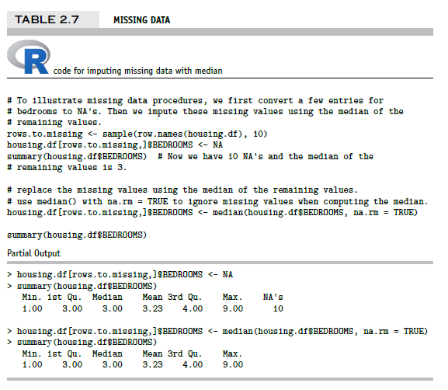
Replacing Missing Data with Median

Slide 28
Normalizing (Standardizing) Data
Used in some techniques when variables with the largest scales would dominate and skew results
Puts all variables on same scale
Normalizing function: Subtract mean and divide by standard deviation
Alternative function: scale to 0-1 by subtracting minimum and dividing by the range
  Useful when the data contain dummies and numeric

Slide 29
The Problem of Overfitting
Statistical models can produce highly complex explanations of relationships between variables
The “fit” may be excellent
When used with new data, models of great complexity do not do so well.
Notes:
29

Slide 30
100% fit – not useful for new data
Notes:
30

Slide 31
Overfitting (cont.)
Causes:
  Too many predictors
  A model with too many parameters
  Trying many different models
Consequence: Deployed model will not work as well as expected with completely new data.
Notes:
31

Slide 32
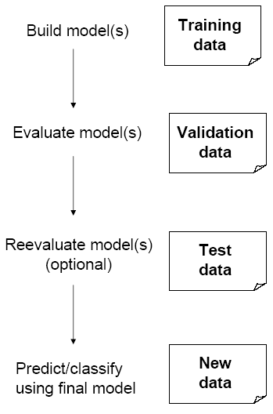
Partitioning the Data
Problem: How well will our model perform with new data?
Solution: Separate data into two parts
  Training partition to develop the model
  Validation partition to implement the model and evaluate its performance on “new” data
Addresses the issue of overfitting

Slide 33
Test Partition
When a model is developed on training data, it can overfit the training data (hence need to assess on validation)
Assessing multiple models on same validation data can overfit validation data
Some methods use the validation data to choose a parameter. This too can lead to overfitting the validation data
Solution: final selected model is applied to a test partition to give unbiased estimate of its performance on new data

Slide 34
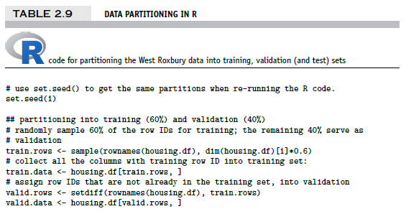
Partitioning the Data

Slide 35
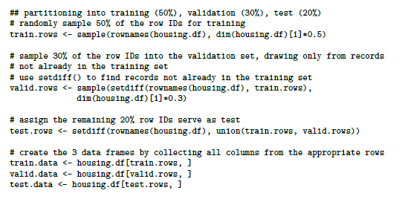
Partitioning the Data into 3 sets

Slide 36
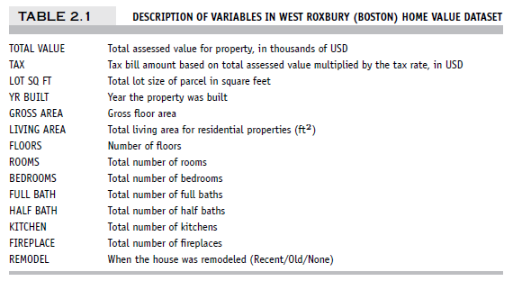
Example – Linear Regression
West Roxbury Housing Data

Slide 37
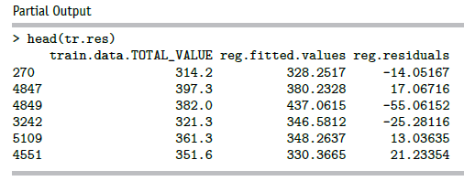
Fit model to the training data
Use lm function (“linear model”):
reg <- lm(TOTAL_VALUE ~ ., data = housing.df, subset = train.rows)
“Scoring” data is getting predicted (= “fitted) values; here for the training data:
reg <- lm(TOTAL_VALUE ~ .-TAX, data = housing.df, subset = train.rows) # remove TAX
tr.res <- data.frame(train.data$TOTAL_VALUE, reg$fitted.values, reg$residuals)
head(tr.res)

Slide 38
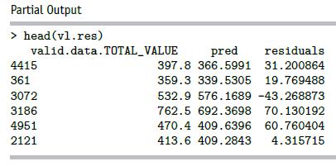
Scoring the validation data
pred <- predict(reg, newdata = valid.data)
vl.res <- data.frame(valid.data$TOTAL_VALUE, pred, residuals =
valid.data$TOTAL_VALUE - pred)
head(vl.res)

Slide 39
Assess accuracy
For the validation data:
library(forecast)
accuracy(pred, valid.data$TOTAL_VALUE)
Output:
ME RMSE MAE MPE MAPE
Test set -1.22575 43.29939 32.26393 -1.376272 8.414937
Potential confusion: the label Test set is used by the forecast package to refer to the data used in the analysis and does not refer to the test partition created earlier. The forecast package is used in all types of modeling analysis, not just data mining, hence the conflicting terminology.

Slide 40
Error metrics
Error = actual – predicted
ME = Mean error
RMSE = Root-mean-squared error = Square root of average squared error
MAE = Mean absolute error
MPE = Pean percentage error
MAPE = Mean absolute percentage error

Slide 41
Summary
Data Mining consists of supervised methods (Classification & Prediction) and unsupervised methods (Association Rules, Data Reduction, Data Exploration & Visualization)
Before algorithms can be applied, data must be explored and pre-processed
To evaluate performance and to avoid overfitting, data partitioning is used
Models are fit to the training partition and assessed on the validation and test partitions
Data mining methods are usually applied to a sample from a large database, and then the best model is used to score the entire database

